Slide 1


3D Chatbot
Presented by
Harsheet Trambadia
Taniya Rajput
Sarthak Tandel

Slide 2



Frontend
React Three Fiber (R3F), Three.js, Tailwind CSS
Project Overview
Backend
Node.js (Express), ElevenLabs SDK, OpenRouter API.
A web-based 3D Chatbot application that allows users to have natural, voiced conversations with an animated avatar.
Processing Tools
Rhubarb Lip Sync, FFmpeg for audio transcoding.

Slide 3
Static Interaction: Traditional chatbots are text-based and lack emotional depth or visual engagement.
01.
Problem Statement
Uncanny Valley: Achieving realistic mouth movements (lip-sync) that match AI-generated speech is technically challenging in a web environment.
02.
Latency Issues: Generating AI text, converting it to speech, and syncing animations usually results in long wait times, breaking the immersion.
03.

Slide 4

01.
Conversational Intelligence Integration
To integrate a Large Language Model (LLM) such as Llama 3 to process user queries and generate contextually relevant, human-like responses in real-time.
04.
Immersive Web-Based 3D Rendering
To architect a performant and responsive 3D user interface using React Three Fiber (R3F) that allows for smooth character transitions and environmental interaction directly in the browser.
02.
High-Fidelity Neural Voice Synthesis
To implement advanced Text-to-Speech (TTS) using ElevenLabs, focusing on generating high-quality audio that captures emotional nuances and natural speech patterns.
05.
Low-Latency Performance Optimization
To optimize the backend-to-frontend data flow (Audio + Lip-sync JSON) to achieve a "Real-Time" feel, minimizing the delay between a user's input and the avatar's response.
Objectives
03.
Automated Phonetic Lip-Sync Pipeline
To develop a robust processing pipeline using tools like Rhubarb Lip Sync or FFmpeg to automatically map audio phonemes to 3D visemes (mouth shapes) for realistic character speech.
06.
Affective Animation & Gesture Mapping
To design a system where the AI’s detected emotional intent (e.g., happy, sad, or curious) dynamically triggers specific 3D animations and facial blend shapes to enhance the avatar's personality.

Slide 5
Methodology
01
02
03
04
05
Input: User sends a text message via the React frontend.
Brain: The backend sends the prompt to Llama 3, which returns a structured JSON (Text + Emotion + Animation).
Voice: The text is sent to the ElevenLabs SDK to generate an MP3 stream.
Processing:
FFmpeg: Converts MP3 to WAV.
Rhubarb: Analyzes WAV to create a phonetic JSON (Lip-sync data).
Output: Frontend receives Audio + Lip-sync JSON + Animation cues and renders them in the 3D scene.

Slide 6
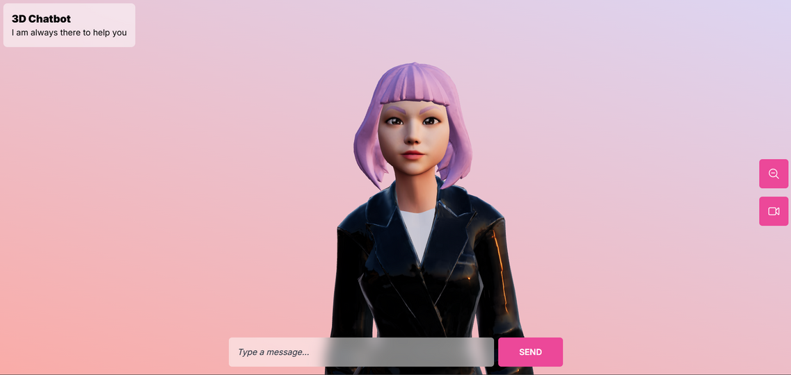
01
Human-like Interaction: The avatar displays facial expressions (smile, sad, angry) corresponding to the context of the conversation.
Results
02
Precise Lip-Sync: Achieved accurate phonetic mouth-movement matching using Rhubarb phonetic analysis.
03
Dynamic Animation: Seamless transition between idle states and specific triggers (e.g., "Talking_1" or "Laughing").

Slide 7
Conclusion & Future Scope
Conclusion: Successfully developed a functional prototype of a 3D AI assistant, demonstrating the potential for more human-centric AI interfaces.
Key Learnings: Mastery of Node.js stream management, 3D character rigging in R3F, and API integration.
Future Scope:
Implementing STT (Speech-to-Text) for fully hands-free conversation.
Adding Vector Databases (RAG) to give the avatar a long-term memory.
Support for multiple languages and custom voice cloning.

Slide 8

The End

